Slide 1

Credit valuation Adjustment
2
+
2
+
For Derivative Contracts

Slide 2


Group Members
2
+
2
+
Fazliddinkhuja Zokirkhonov
Joachim Horzela
Klaudia Dobosiewicz
Taras Kryvyy
Vincent Ibia

Slide 3
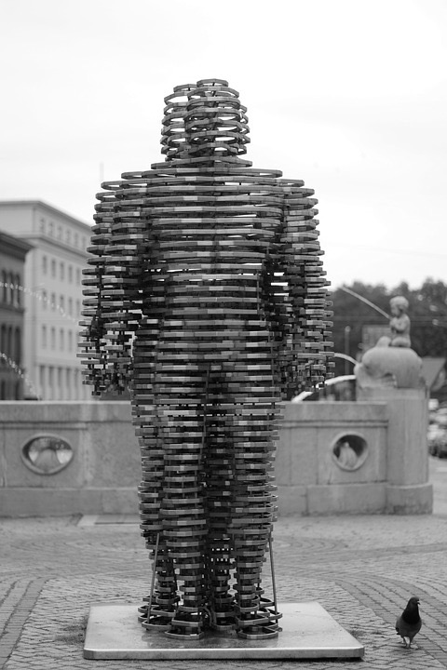
Title
Table of Contents
Figures & Formulas
What we’re doing and why
The instruments involved and how they work
The market and major use cases for these instruments
The contract adjustments
Recommendations
Figures & Formulas
IRS Time-zero Valuation
CIRS Expected Exposure Graph
IRS Expected Exposure Graph

Slide 4

What we’re doing and why
2
+
2
+
2
+
.

Slide 5

We’re paying too much
2
+
for certain contracts.
Credit valuations adjustments are simply repricings of derivative instruments.
We assert that the instruments are overpriced, and adjust (typically lower) this price by taking into account an additional form of risk.
That risk is called counterparty credit risk.

Slide 6

The instruments involved
2
+
2
+
2
+
and how they work

Slide 7
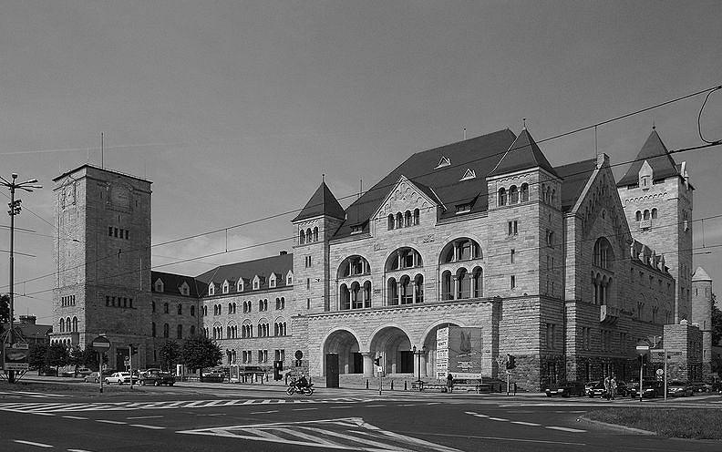
Foreign exchange Forward
2
+
Agree today. Buy tomorrow.
A potential contract to purchase 100 000 EUR in one year, at EUR/PLN exchange rate of 4.393.
Should the EUR/PLN exchange rate increase, such that it’s above 4.393 at contract maturity, we’ll profit on this contract.

Slide 8
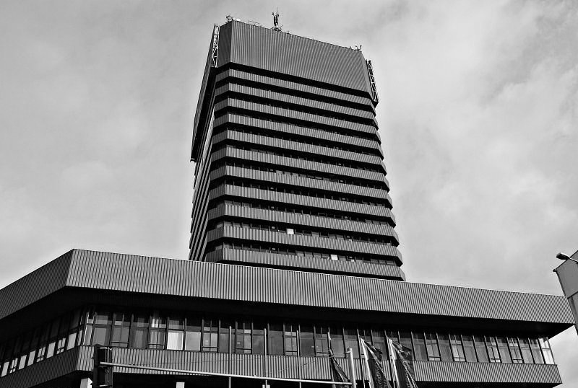
Interest Rate SWAP
2
+
Receive fixed. Pay floating.
A potential 3-year contract on the WIBOR. Quarterly, floating payments of the 3-month rate, while receiving 2.2144% annually.
Payments in both directions are calculated on a 500 000 PLN notional amount.
Our gain would come from the average annual rate over the contract life, to be below 2.2114%

Slide 9

Cross currency IRS
2
+
Variable Investment. Foreign Interest.
A potential contract to swap 430 000 PLN, for 100 000 EUR; and return the EUR notional in 3 years. For the duration of the contract, we pay a fixed rate of -0.0575% in EUR, and receive, quarterly, the 3M WIBOR.
Intermediary payments will influence out chance at gains here. Moreover, we aim to receive a greater amount of PLN at contract maturity.

Slide 10
The market
2
+
2
+
2
+
and major use cases for these instruments

Slide 11

E.U. Market size
2
+
EUR 660tn (EOY 2017)
Interest rate derivatives (IRD) made up over two-thirds of the notional value on the market. This was an overwhelming majority. Currency derivatives (CUR) were second most used, followed, in order by derivatives on Other assets (OTH), on Equities (EQU), on Commodities (COM), on Credit (CRD).
The Unclassified category (UNC) represents error/discrepancy in reporting data.
- ESMA (2018)

Slide 12

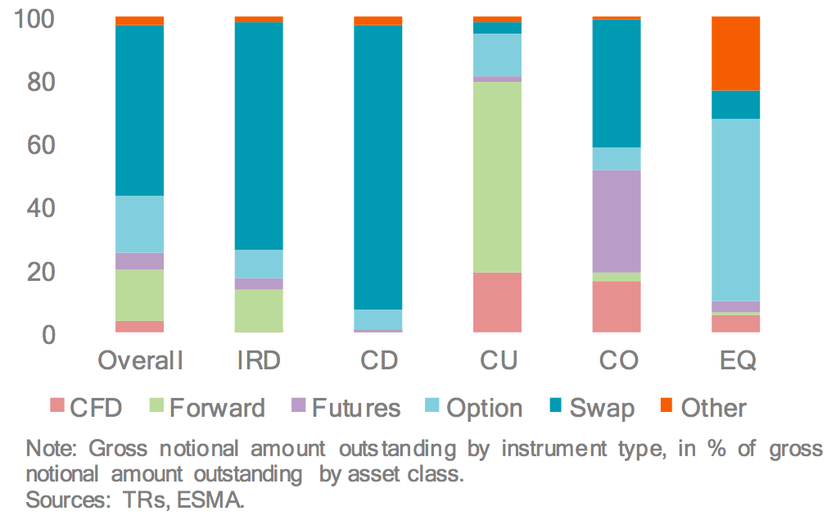
E.U. Contract Prevalence
2
+
European Union Derivatives Market
Gross notional by contract type
2
+
Swaps account for 50% overall
Swaps are the most utilized form of derivative on the EU market, comprising fifty percent of the outstanding notional value.
By contract type, Swaps dominate Interest Rate Derivatives (IRD), and Credit (CD). While the Forward was most common for Currency derivatives (CU). Options were the leading contract for Equity derivatives (EQ), and Commodities (CO) had Futures and Swaps in similar amounts.
CFD – contracts for difference
- ESMA (2018)

Slide 13
Derivatives use cases
2
+
Reasons to place your bets
Given the market size and liquidities implied by the previous slide, we think the following are top uses cases for one or more of our contacts in question:
1. Hedge risk in against both interest rates, and foreign exchange with one instrument
2. Utilize as a fixed financing cost, such as for a short-term project
3. Offset a similar type of exposure present in your portfolio

Slide 14

THE CONTRACT ADJUSTMENTS
2
+
2
+
2
+

Slide 15
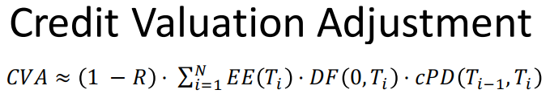
FX Forward ≈ 22.465 IRS ≈ 161.459 CIRS ≈ 118.765 CVA>0 implies a lower, risk-adjusted price
2
+
2
+
2
+

Slide 16
What we recommend
2
+
2
+
2
+
.

Slide 17
Reasons to LONG the FX Forward
2
+
Recommendation # 1
With a short-term contract, the implied probabilities from the market’s CDS instruments suggest a less than 1% chance (0.654%) of counterparty default. (CVA 22.465)
Additionally, the simulation of the FX risk-factor (EUR/PLN rate), has a drift in favor of the Euro (.0179).
If we take the long position, we stand to gain when the Euro is slightly more expensive one year from now.

Slide 18
Reasons to INVEST IN the IRS
2
+
Recommendation #2
We recommend going long in the IRS derivative. It’s max expected exposure is of course far less than the CIRS (sim avg 10.4k PLN @12m). No FX to worry about.
Moreover, our CVA adjustments for this product implies it’s overpriced. When properly priced, though there is 0 exchanged at contract start, the counterparty should be offering a higher fixed rate.

Slide 19
REASONS TO FOREGO The CIRS
2
+
Recommendation # 3
A negative IR on the Euro could last as long as our investment horizon. A return later, to a positive figure would therefore not affect our position.
While the proposed, fixed EUR interest rate is slightly negative (-0,0575%), the exposure profile of this instrument is not encouraging.
When we add in the implied default probability of around 4.8% (4.7478) at the end of the contract, and a maximum exposure typically over € 70K, the plain IRS seems like a better option.

Slide 20
Figures and formulas
2
+
2
+
2
+
.

Slide 21
2
+
2
+
$$V^{receiver}=Nr_{IRS}\left(d(1)+d(2)+d(3)\right) −N\left(\frac{f_{0,0.25}}{4}d(0.25)+\frac{f_{0.25,0.5}}{4}d(0.5)+…+\frac{f_{2.75,3}}{4}d\left(3\right)\right)$$
With a CVA of 161.459, the IRS contract is “overpriced” under normal valuation.
This means the floating leg is overpaying, because the fixed leg uses a rate that is not adjusted for default risk.

Slide 22
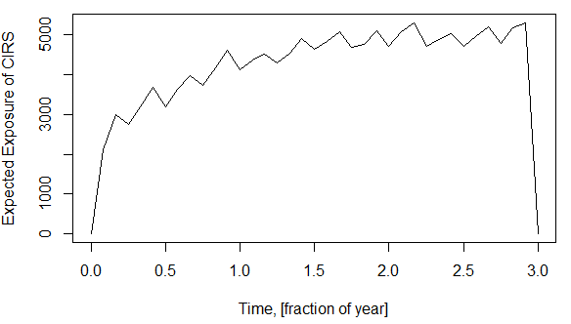
2
+
CIRS Exposure max – 78682.61
CIRS EE mean – 4160.09

Slide 23
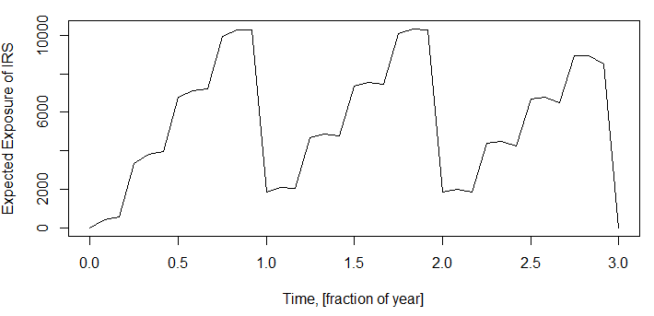
2
+
IRS Exposure max – 10446.77
IRS EE mean – 5471.88

Slide 24
THANK YOU
2
+
2
+
Questions? Comments?

